Slide 1
POINTS
350 PREDATORS
3 TARGETS
FIND CLOSEST TARGET
FLOW RANDOMLY
FLOW TOWARDS POINT
CONTINOUSLY EVALUATE DISTANCE BETWEEN GOAL AND CLOSEST POINT
KEEP FOLLOWING TARGET
KEEP FOLLOWING TARGET
CONNECT CLOSEST PREDATORS RELATIVELY
IF D<y
BOOST GOAL SPEED
IF x<D
REDUCE GOAL SPEED
CREATE TRIANGLE
EVALUATE AREA
AT INSTANCES OF X<A<Y
RECORD CONECTION

Slide 2
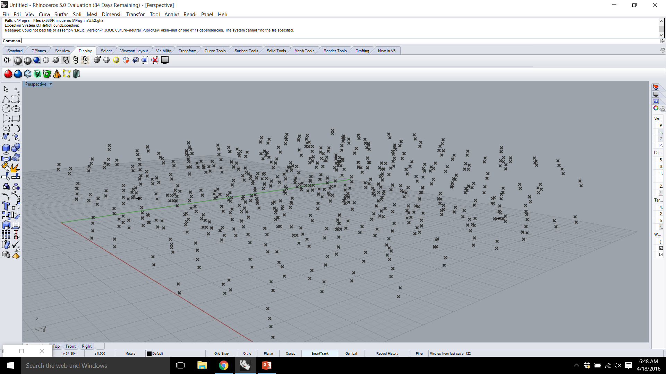

Slide 3
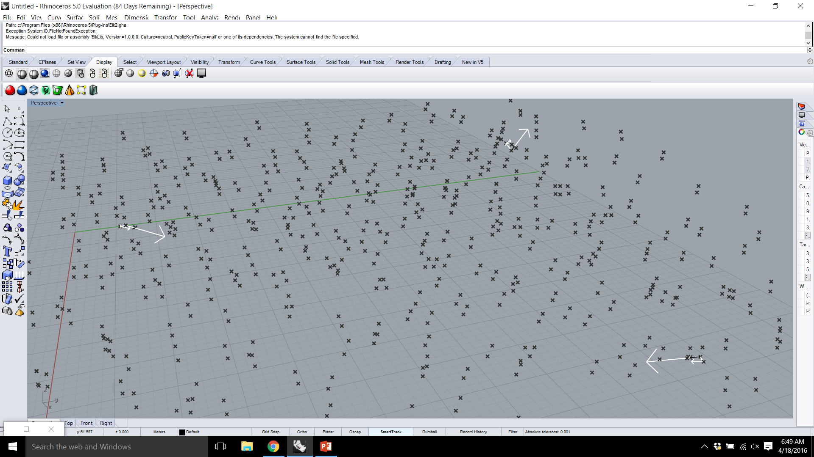

Slide 4
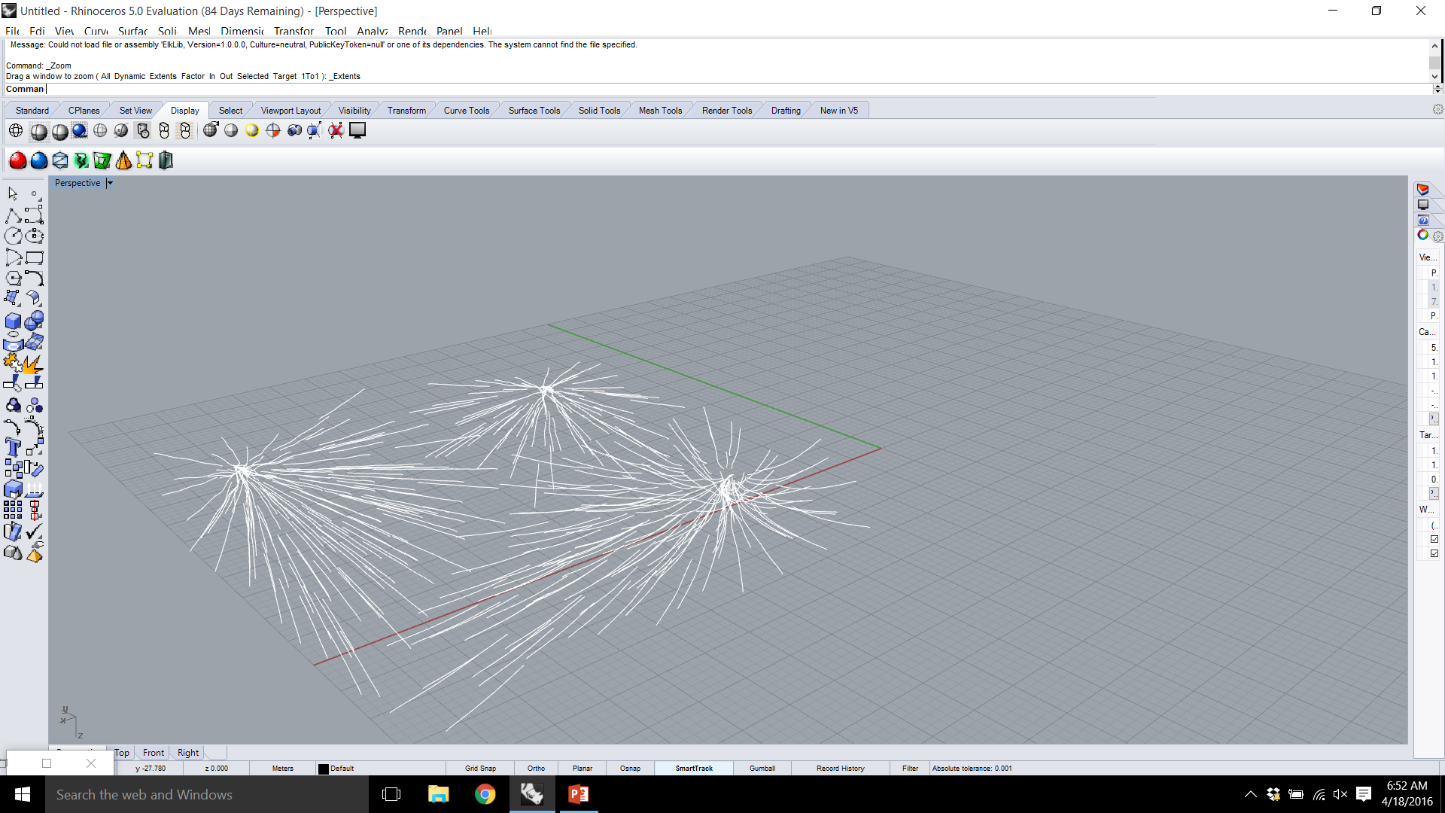

Slide 5
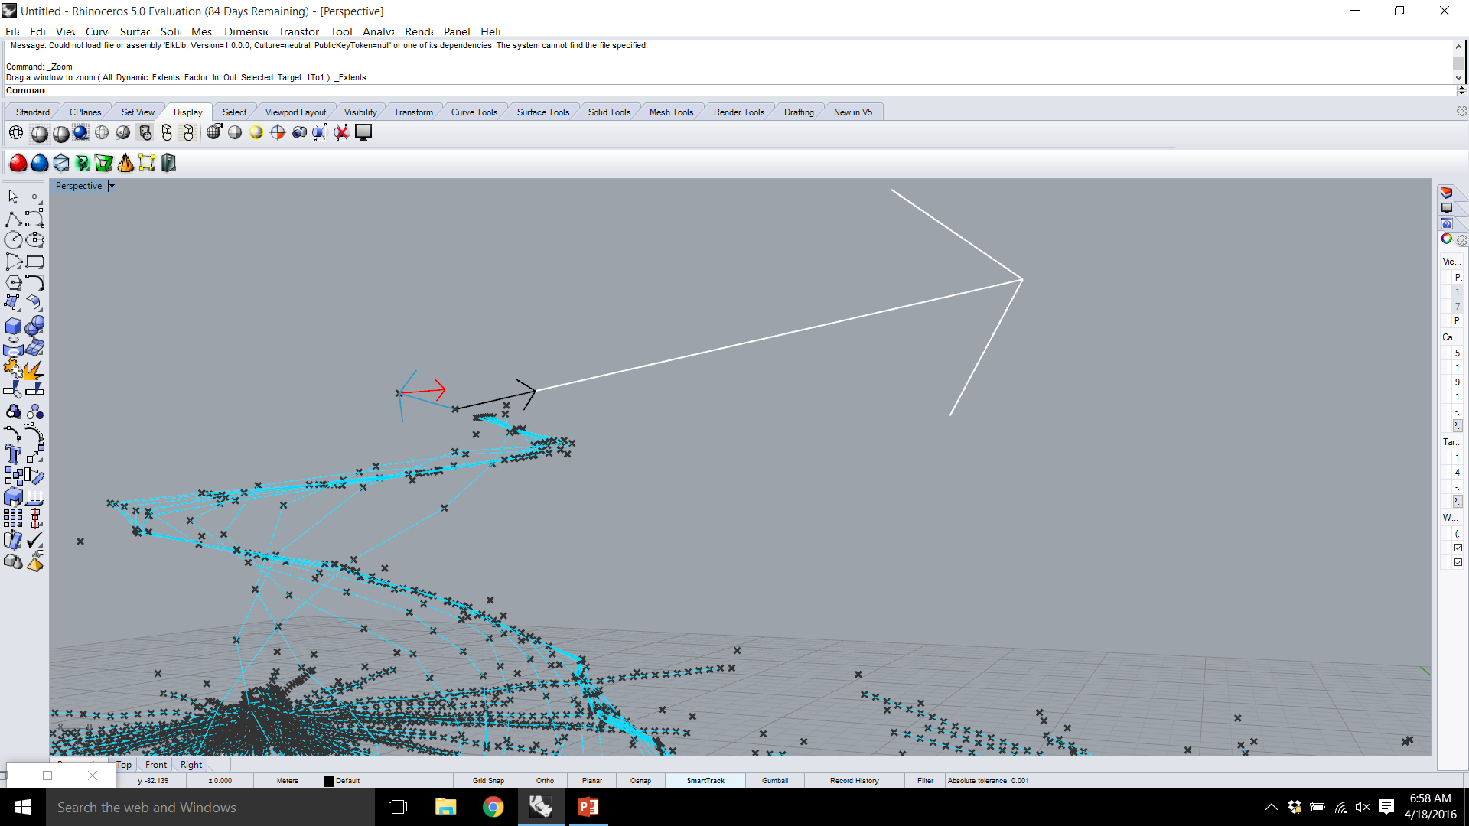

Slide 6
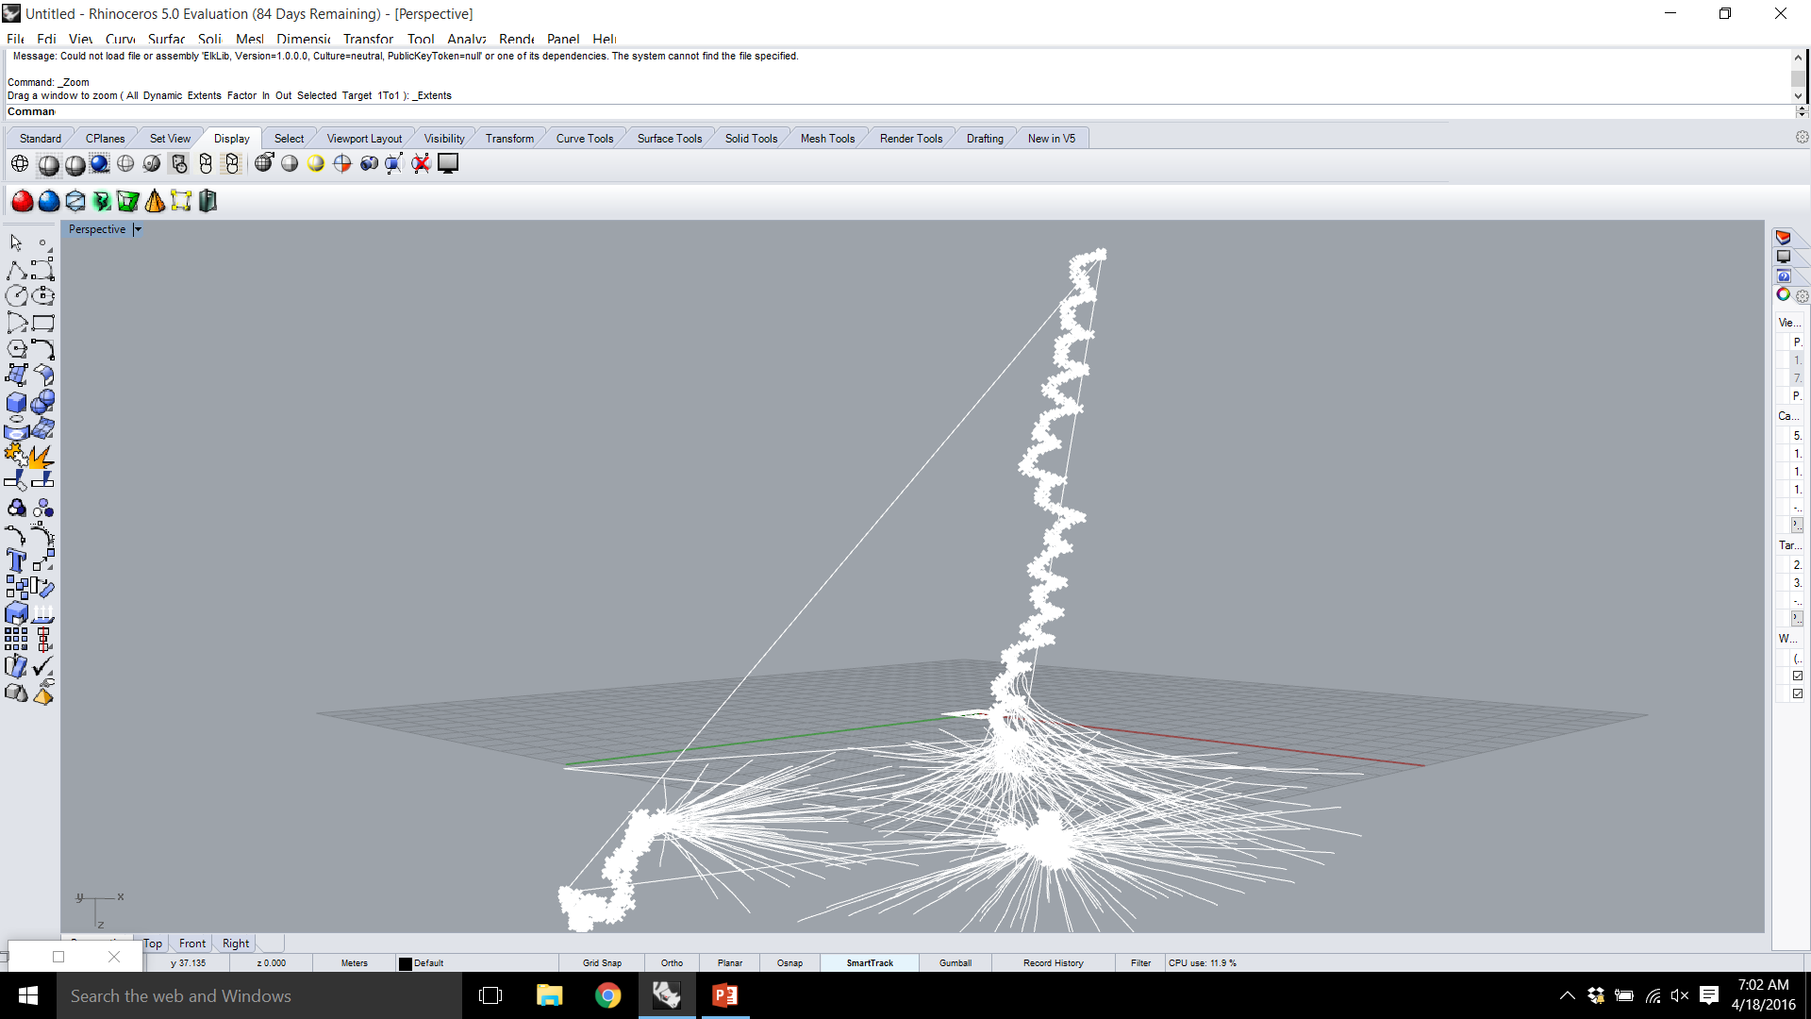

Slide 7
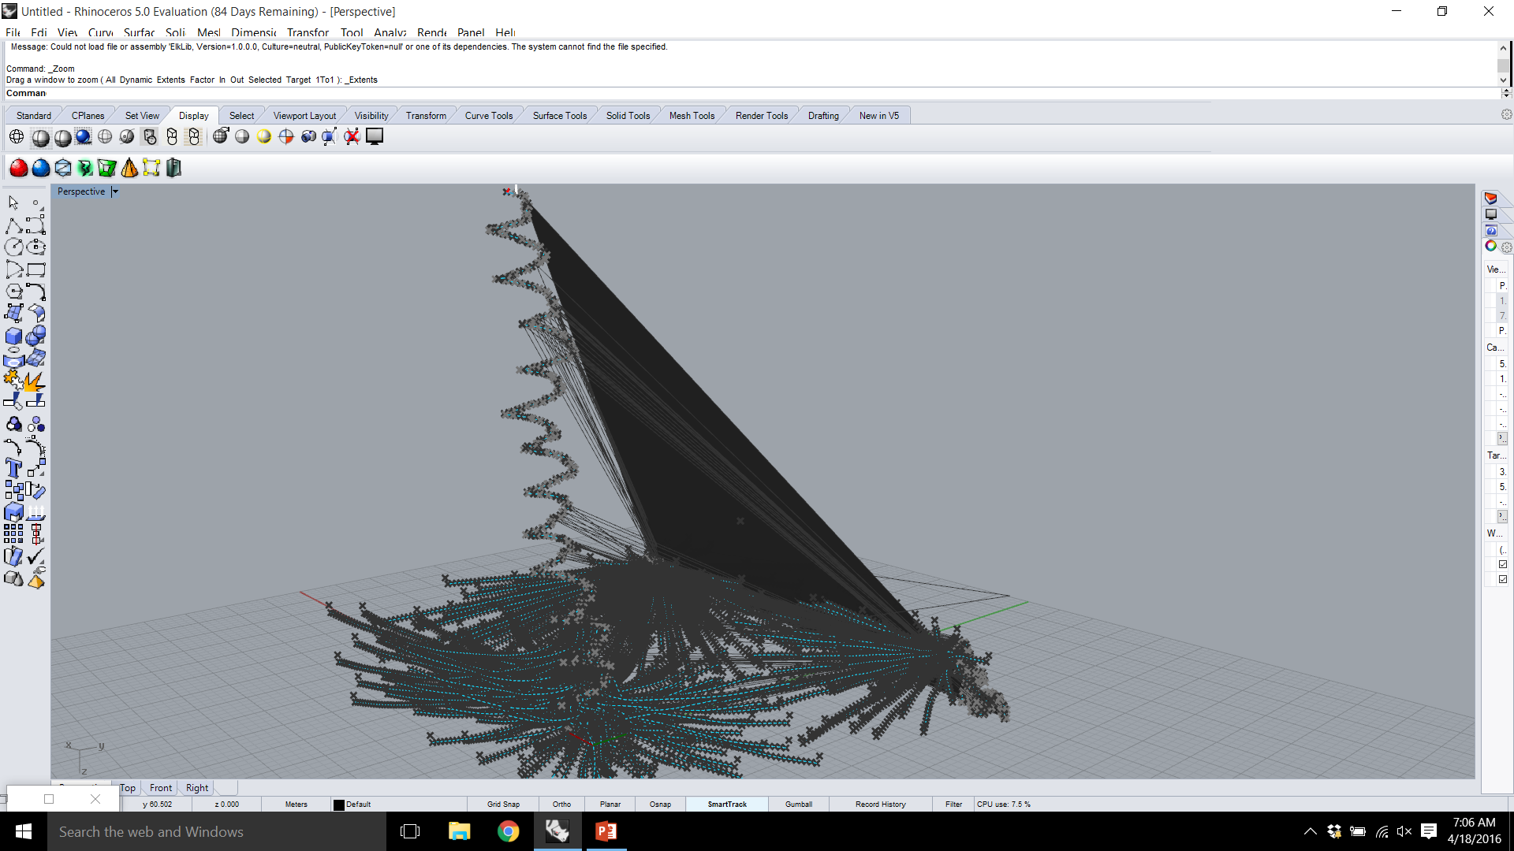

Slide 8
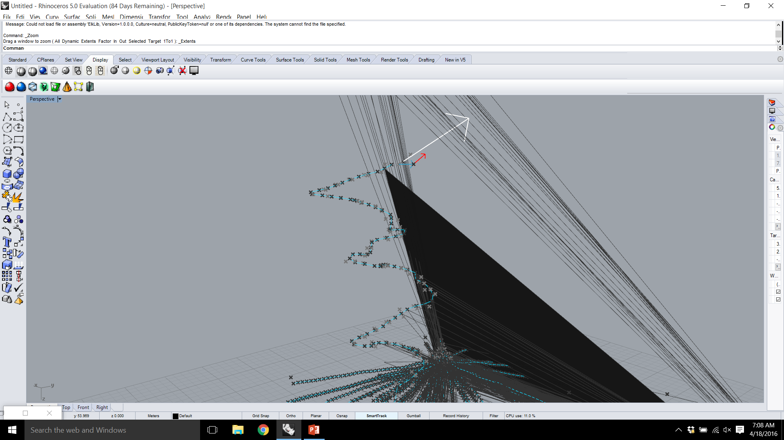

Slide 9
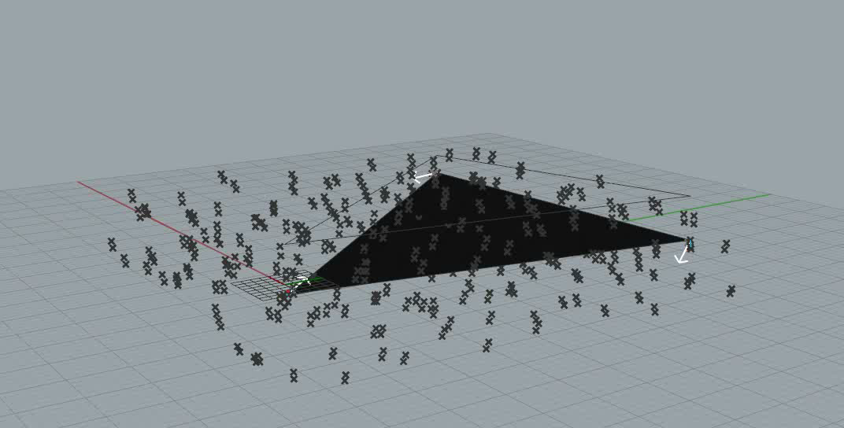

Slide 10
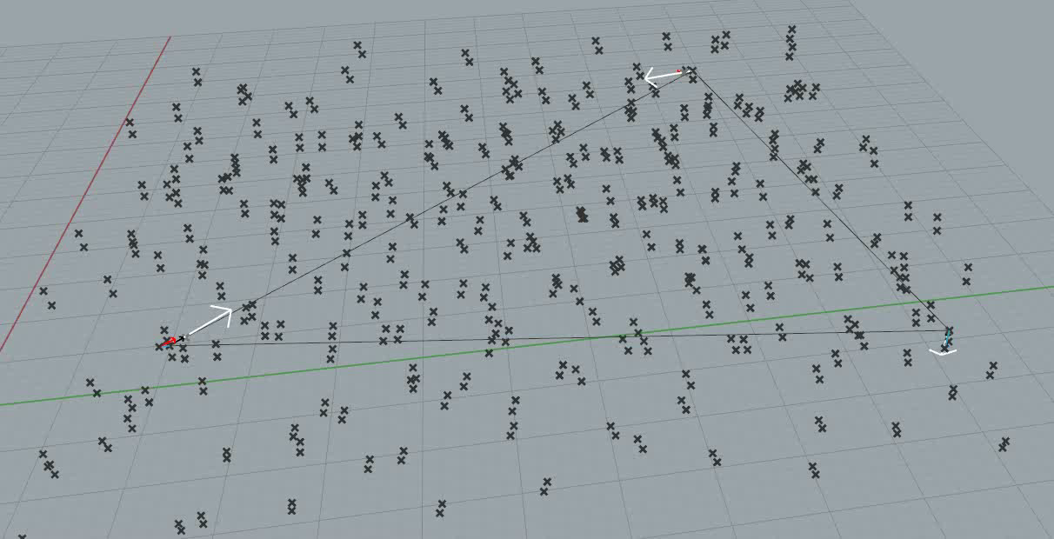

Slide 11


